Slide 1
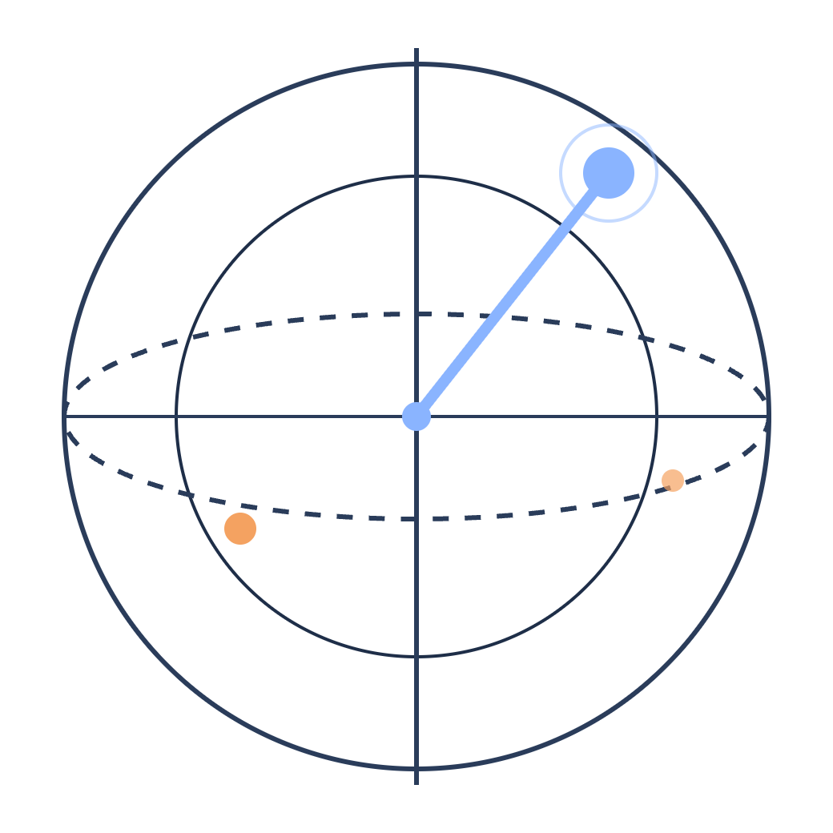
Learning molecular dipoles from fewer labels
QISKIT FALL FEST 2026 · UOTTAWA · PROMPT 07
Quantum kernel regression vs classical models on QM9
Team Honey Pack Research · Roman Daher · Douglass Jeffrey · Jadon Xia · October 2026
Notes:
(~20 s) Hi, we're [team]. Our prompt was QML Advanced, number 07: learn molecular dipoles from fewer labels. We built quantum regression models in Qiskit, compared them fairly with classical models, and ran one on real IBM hardware.

Slide 2
“How much reference data does a model need to predict molecular polarity?”
The dipole moment |μ| measures how far a molecule’s positive and negative charge are pulled apart; it drives solubility, intermolecular forces and spectroscopy. Every label in QM9 is a density-functional-theory calculation, so a model that needs fewer labels saves real compute. Quantum kernels are often proposed for exactly this small-data regime.
01
02
03
04
How fast does error fall as labels grow?
Can a quantum model match its classical twin?
Do models extrapolate to formulas never seen in training?
Does it survive shots, noise and real hardware?
Notes:
(~50 s) The prompt asks: how much reference data does a model need to predict molecular polarity? The dipole moment measures charge separation in a molecule, which matters for solubility, intermolecular forces and spectroscopy. Each reference label is an expensive DFT calculation, so needing fewer labels is valuable, and that small-data regime is exactly where quantum kernels are often said to help. We turned that into four questions: how error falls with labels; whether a quantum model beats a classical model given the same inputs; whether models generalize to formulas they have never seen; and whether the quantum model survives finite shots, noise and real hardware.

Slide 3


Predict how polar a molecule is from its structure
INPUTS, FROM QM9
Atoms and their 3D positions
OUTPUT
Z: the atomic number of every atom (H, C, N, O or F)
Regression model
Dipole moment magnitude |μ|, in debye (D)
R: the x, y, z coordinates of every atom, in ångström
quantum or classical
Charge separation: how much charge is pulled apart, times how far
3 to 29 atoms per molecule, up to 9 of them heavier than hydrogen
Methane 0 D · water 1.85 D · QM9 average 2.7 D
Each QM9 label took a quantum-chemistry (DFT) calculation, so a model that needs fewer labels saves real compute. |μ| does not change when a molecule is rotated or moved, so neither may the model.
Notes:
(~40 s) The task: given only a molecule's atoms and their 3D positions, predict its dipole magnitude. From QM9 we use two inputs per molecule: the atomic number of every atom, which says whether it's hydrogen, carbon, nitrogen, oxygen or fluorine, and every atom's x, y, z coordinates. The output is the dipole magnitude in debye, a measure of how much charge is separated inside the molecule. For scale, methane is zero, water is about 1.85, and the QM9 average is 2.7. Each label in QM9 cost a quantum-chemistry calculation, which is why learning from fewer labels matters.

Slide 4
How do we evaluate the models?
TRACK A
TRACK B
Best Performing Classical Model?
Can we design a useful Quantum Model?
How far can classical go from atoms and geometry?
How does Quantum perform under the same inputs?
Up to all 99,198 training labels
All 188 features
Ridge, RBF kernel ridge, XGBoost, and a latent-charge network
At most 1,000 labels (N = 100, 300, 1,000)
The same 10 inputs, one per qubit
Same scaling, target, CV folds and 88-candidate grid
Notes:
(~50 s) "Best classical model" and "the classical model a quantum model can fairly be compared with" are different questions, so we answer both. Track A asks how accurate classical can get, with all the data and the richest inputs. Track B is the quantum model's classical twin: same 10 inputs, same training sets, same folds, same tuning budget. We fixed this protocol before computing any quantum result, and we unit-tested that the quantum tuning code gives exactly the classical answer when you hand it an RBF kernel. So any difference between the quantum model and its twin comes from the kernel itself.

Slide 5
QM9: 133,885 molecules
DATA
Published QM9 (figshare collection 978904)
133,885
Uncharacterized: the optimized geometry no longer matches the intended molecule
− 3,054
Hard to converge, flagged in QM9’s readme (11 listed, 3 already removed)
− 8
Duplicates: the same molecule listed twice; we keep one copy so no molecule sits in two sets
− 140
Final cleaned dataset
130,683
Ramakrishnan et al., Sci. Data 1, 140022 (2014) · all files verified against figshare’s MD5 checksums · 0 parse failures
Notes:
(~45 s) The dataset is QM9: about 134 thousand small organic molecules containing only carbon, hydrogen, nitrogen, oxygen and fluorine. Their geometries and dipoles were computed with density functional theory, so they are reference calculations rather than experiments. We removed 3,202 molecules. 3,054 are ones QM9's own authors flag as uncharacterized: after the geometry was optimized, it no longer matched the molecule it was supposed to be. 8 more are listed in the readme as hard to converge. And 140 are duplicates: the same molecule listed twice, which we removed so a molecule can never end up in both training and test. That leaves 130,683 molecules.

Slide 6
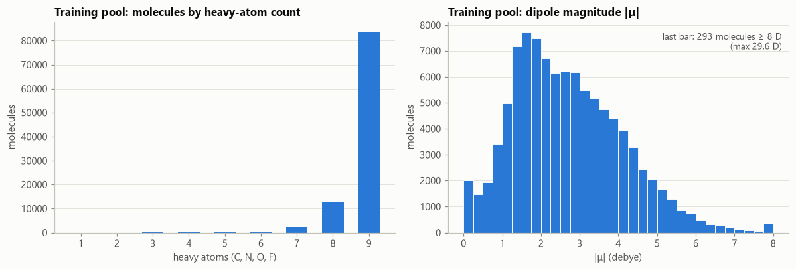
QM9, split by whole formulas
DATA
130,683
small organic molecules (up to 9 heavy atoms: C, N, O, F) with DFT geometries and dipoles
Set | Molecules | Formulas | Role
Training pool | 99,198 | 497 | General pool for training models
dev | 5,000 | 257 | Model development
dev_unseen | 4,183 | 26 | Development, held-out formulas
test_familiar | 5,484 | 257 | Test: formulas seen in training
test_unseen | 16,818 | 93 | Test: formulas never seen
What’s in it?
Small organic molecules from the GDB-17 enumeration: C, H, N, O and F only
Where labels come from?
DFT calculations (B3LYP/6-31G(2df,p)), not lab measurements
Any extreme outliers?
Rare zwitterions up to 29.6 D, still valid in our model
Notes:
(~45 s) We used QM9: after removing molecules the dataset itself flags as unreliable, plus duplicates, about 130 thousand molecules remain. The key design choice is that we hold out whole formulas. test_unseen contains 93 chemical formulas that never appear in training or development, so the model can't fall back on having seen that formula before. test_familiar has formulas that are in training. Development sets mirror the same split. Training sets are nested, from 100 up to the whole pool of about 99 thousand, with three seeds, and every model uses identical sets, so comparisons are paired.

Slide 7
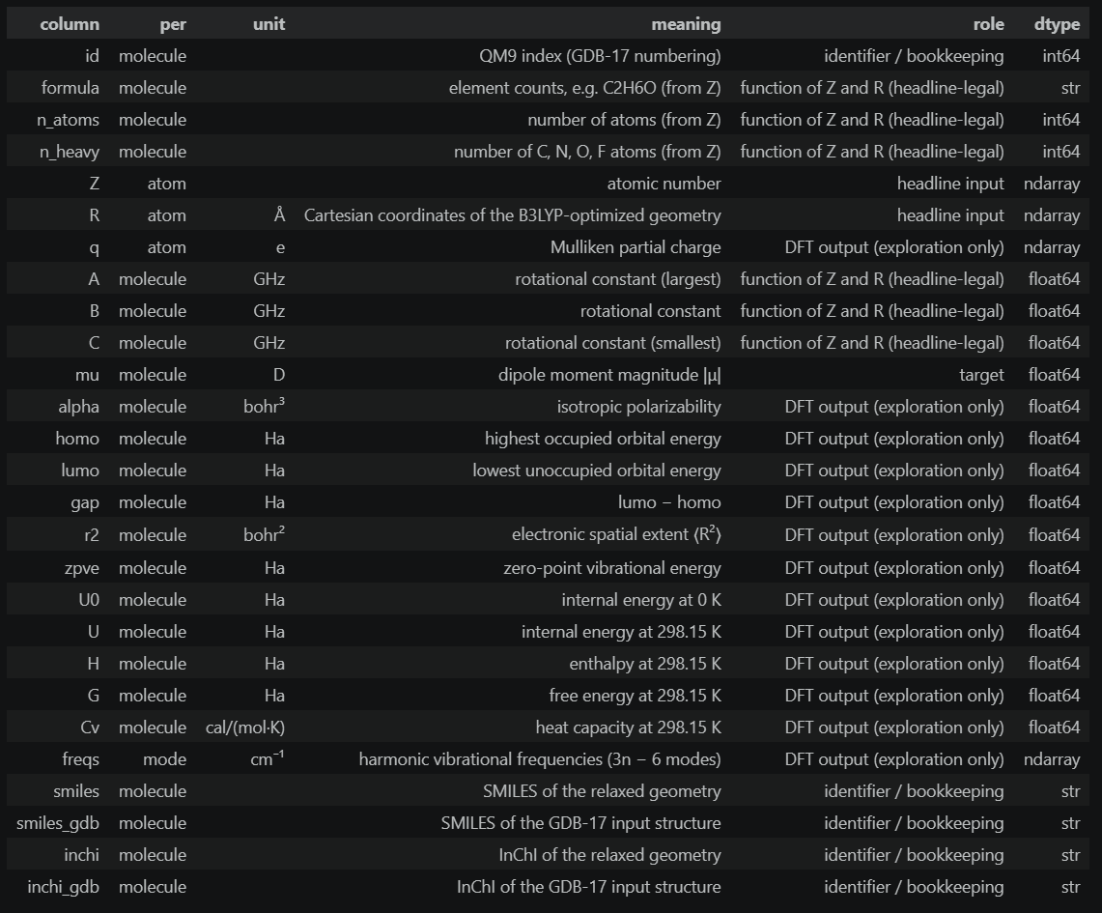
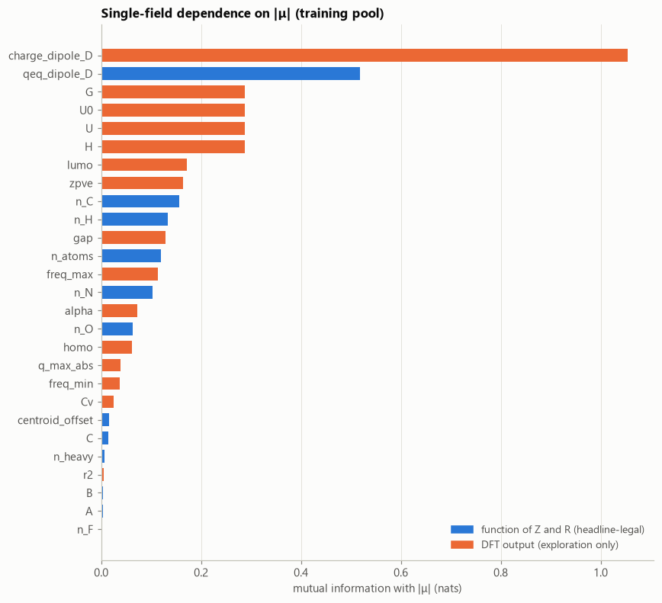
Why we left QM9’s DFT outputs out of our training features
CONSTRAINTS
Circular at prediction time
To get them for a new molecule you would run DFT, and that run already gives |μ|. The model would predict nothing new.
They leak the answer
The Mulliken point-charge dipole tracks |μ| at r = 0.94 (MI 1.05), twice as informative as our best legal feature.
Notes:
(~40 s) QM9 contains much more than the dipole: atomic charges, orbital energies, total energies and so on. But all of these come from the same DFT calculation that produced the dipole, so we didn't use them as inputs, for three reasons. First, it's circular: to get them for a new molecule you'd have to run DFT, and DFT already gives you the dipole. Second, they leak the answer: a dipole built from the DFT charges tracks the true dipole at a correlation of 0.94. Third, the brief asks what the dipole is given the structure, so atoms and coordinates only. We used the DFT outputs only to explore and interpret our models.

Slide 8
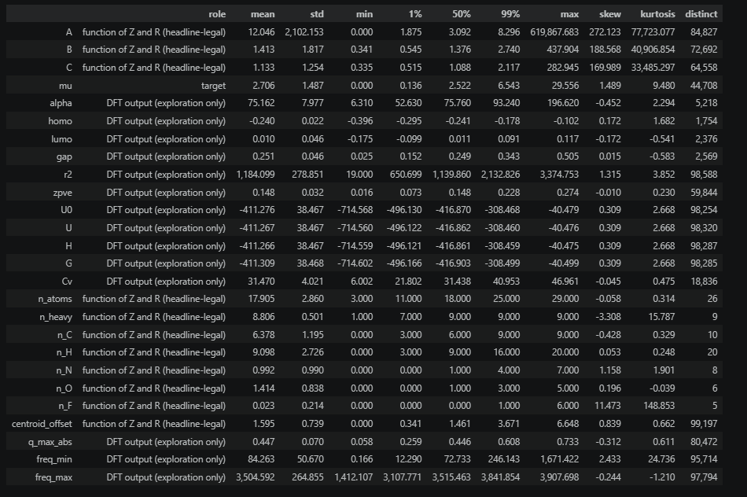
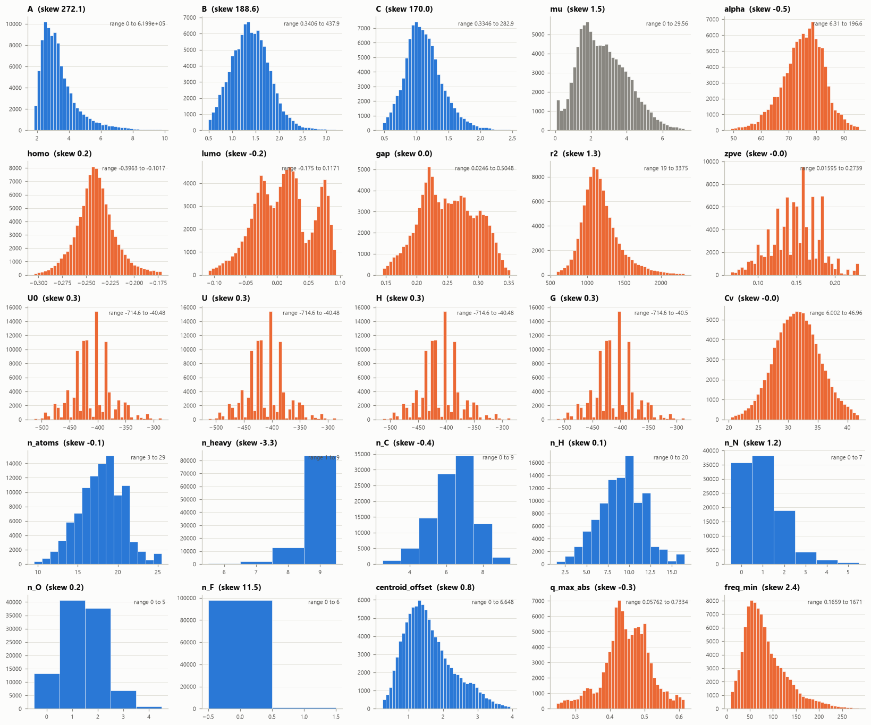
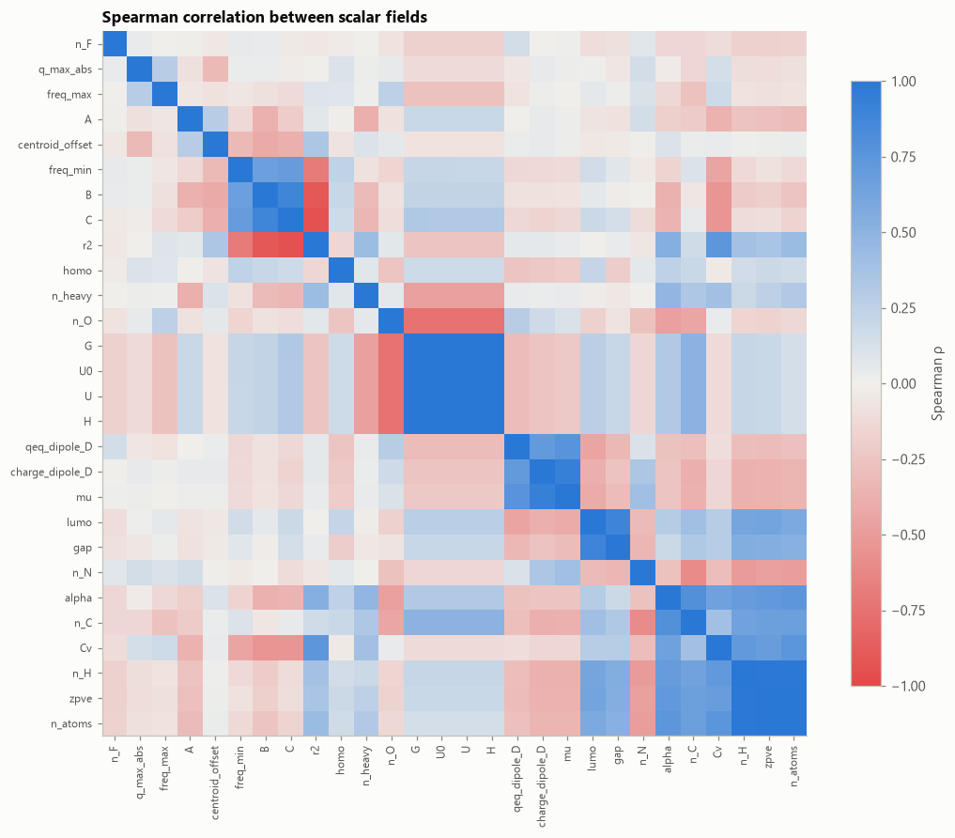
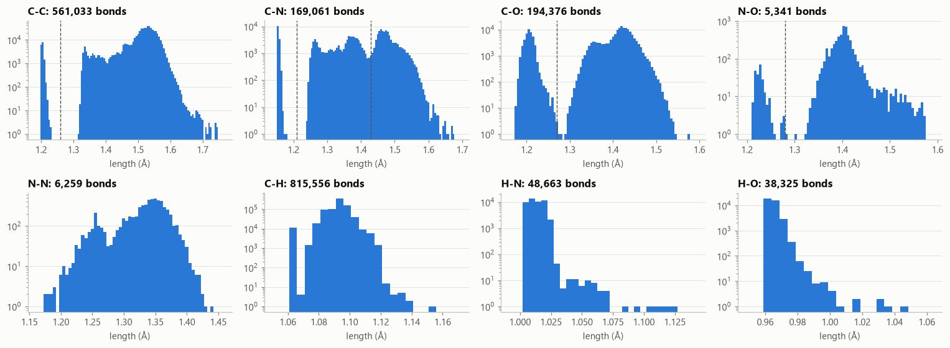
EXPLORATORY DATA ANALYSIS
Notes:
Douglass will talk about this

Slide 9
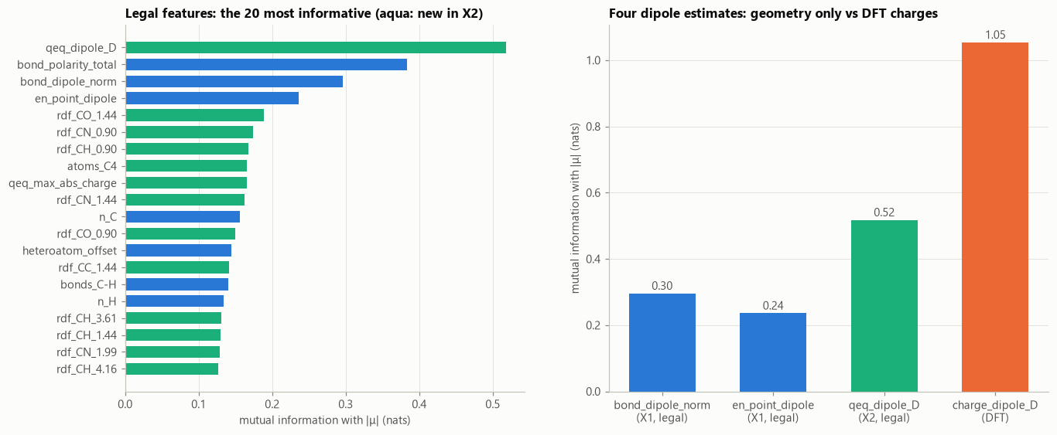
Best features: physics estimates of the dipole
FEATURE ENGINEERING
QEq dipole
I(Qeq; |μ|)= 0.52
Charge equilibration gives each atom a charge by balancing tabulated electronegativities against Coulomb repulsion on the real geometry, then sums |Σ qᵢ rᵢ|. No fitting at all.
Total bond polarity Σ|Δχ|
I(Σ|Δχ|; |μ|)= 0.38
Sum of the magnitude of bond polarity.
Bond-dipole norm ||Σ Δχ·û||
I(|Σ Δχ·û|; |μ|)= 0.30
Each bond’s electronegativity difference, pointed along the bond and added as vectors, so bonds that cancel (as in CO₂) sum to zero.
I(X;Y): Estimated mutual information using sklearn mutual_info_regression. Measured in nats. (0 means independent).
Notes:
(~50 s) We turned each molecule into 188 numbers, all computed from the atoms and coordinates: element counts, eigenvalues of the Coulomb matrix, bond and geometry features, functional groups, and radial distributions, which are histograms of the distances between each pair of elements. The most useful features turned out to be physics estimates of the dipole itself. The best is a charge-equilibration dipole: a classic chemistry model that gives each atom a partial charge from tabulated electronegativities and the geometry, then adds up charge times position. It needs no fitting, and shuffling it makes XGBoost three quarters of a debye worse. Next comes a bond-dipole sum: each bond's polarity, pointed along the bond and added as a vector, so symmetric molecules like CO2 cancel to zero.

Slide 10

188 legal features from atoms and geometry
FEATURE ENGINEERING CONT.
5
29
26
Composition
Coulomb-matrix spectrum
Geometry and bonds
Counts of C, H, N, O, F
Sorted eigenvalues of nuclear repulsion
Bond lengths and orders, rings, moments of inertia
19
3
106
Functional groups
QEq dipole
Radial distributions
Including the charged groups of zwitterions
Charge-equilibration estimate: the best single feature
Pair-distance histograms per element pair
Invariant to rotation, translation and atom relabeling: features change by at most 1e-12, while a raw-coordinate negative control changes by ångströms.
From 323 total legal features, 135 were removed for low/zero variance, high spearman correlation magnitude, or redundancy.
Notes:
(~40 s) As the brief asks, every input comes from the atom types and 3D coordinates only. QM9 also contains things like DFT charges, but those come from the same calculation as the answer, so we used them only for exploration. We engineered 188 features in six blocks. The strongest single feature is a charge-equilibration dipole: a classical physics estimate computed from geometry with no fitting. A dipole magnitude doesn't change if you rotate or move a molecule or relabel its atoms, so the features must not either. We test that, with a negative control that must fail, so we know the test can catch a broken feature.

Slide 11
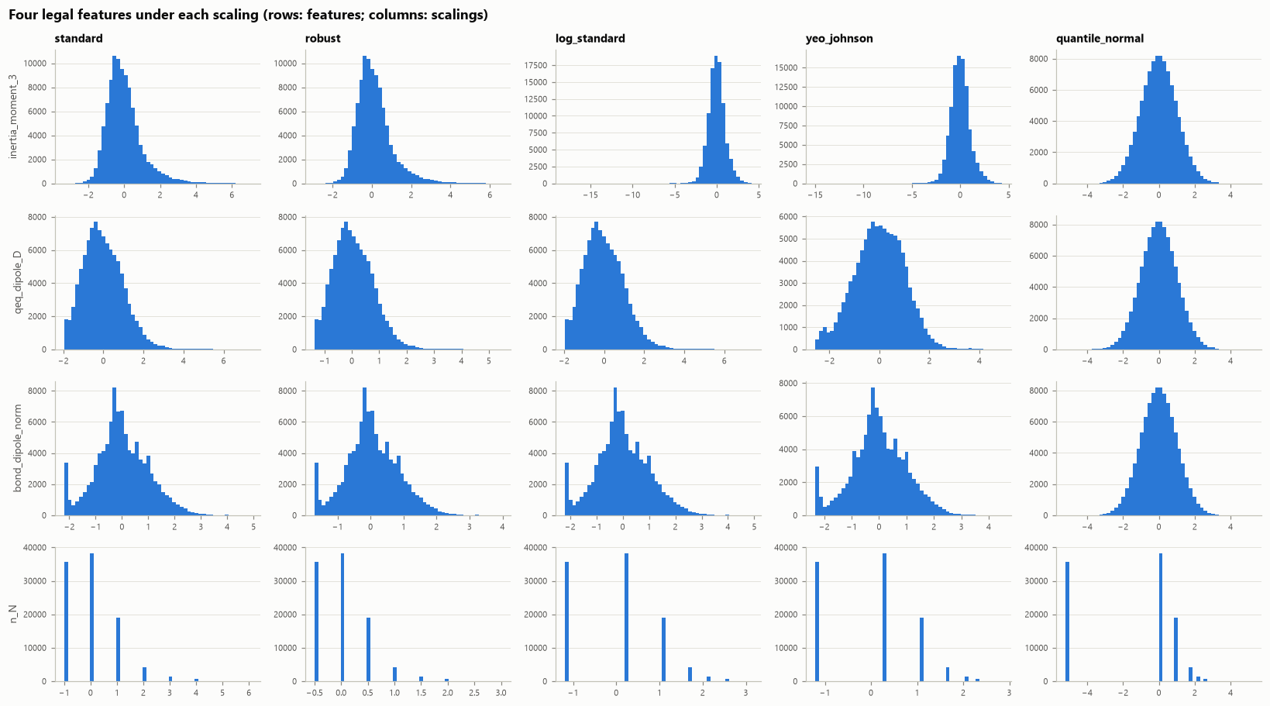
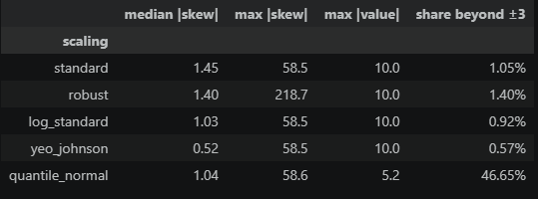
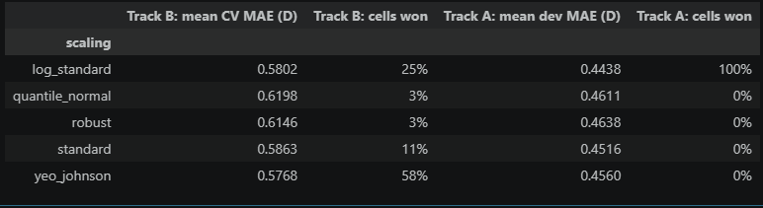
STANDARDIZATION
Feature scaling
TRACK A - LARGE-DATA CLASSICAL
Log-standard + standardized |μ|
Best dev MAE in 6/6 cells: 0.445 D vs 0.452 D with z-scores. Standard target: 0.4208 D vs 0.4226 D for √ target.
TRACK B - QUANTUM COMPARABLE
Yeo–Johnson + √|μ|
Yeo-Johnson won 58% of paired CV cells (0.577 D mean MAE). √ target: 0.5752 D vs 0.5863 D for standard.
“Cell” refers to a combination of SL/ML Model, Feature set, Training size, Random seed.
For both tracks, multiple differing cell configurations were run for each scaling method. The winning scaling method for a cell was the method yielding the lowest cross validation MAE.
In this way we experimentally proved that Yeo-Johnson was optimal for these applications.
Notes:
DJEFFREY ERRORS HERE

Slide 12
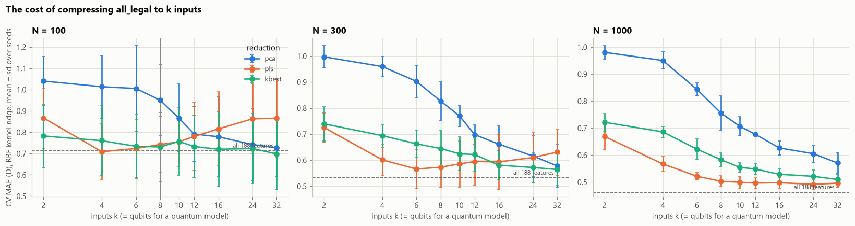
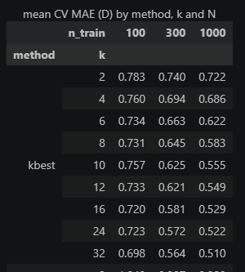
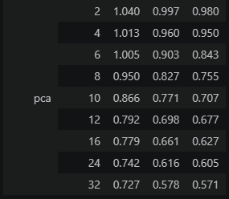
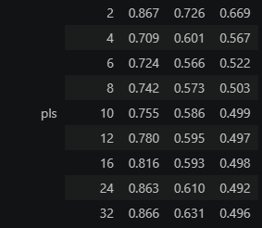
Compressing 188 features into 10 qubit inputs
REPRESENTATION
TRACK B
One input per qubit, so 188 features had to become 10. We tested three methods with the same model:
PCA
The 10 directions of largest spread; ignores |μ| entirely
0.707 D
Top 10 by mutual information
Keep the 10 single features most informative about |μ|
0.555 D
Partial least squares (PLS) · chosen
The 10 directions that vary most together with |μ|
0.499 D
MAE from 5-fold cross-validation, RBF kernel ridge, 1,000 training labels. Why 10: the fewest components within one standard error of the best (24 components, 0.492 D). PLS is supervised and uses the target feature, so it is refit inside every training fold.
Notes:
(~40 s) A quantum circuit takes one input per qubit, and we budgeted 10 qubits, so the 188 features had to be compressed to 10 numbers. We compared three methods with the same classical model. PCA keeps the directions where the data varies most, but it never looks at the dipole, and it did worst. Picking the 10 individually best features did better. Partial least squares finds the directions that vary together with the dipole, and it won clearly, so every quantum model and its classical twin use those 10 PLS components. Ten was the fewest components that came within noise of the best result. Because PLS uses the labels, we refit it inside every training fold so no validation or test answer leaks in.

Slide 13
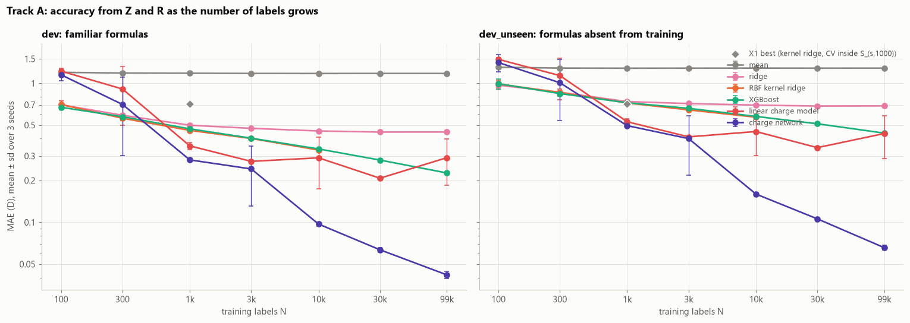
Classical models
MODELLING
TRACK A
To produce the “best” classical model, we created 6 different models using the 188 legal features, averaging their MAE over 3 seeds for each training set.
Models were standard, kernel and RBF kernel ridge, XGBoost, a linear charge model and a charge neural network. (We trained many others but these were the ones that had significant performance)
Notes:
(~40 s) A quantum circuit takes one input per qubit, and we budgeted 10 qubits, so the 188 features had to be compressed to 10 numbers. We compared three methods with the same classical model. PCA keeps the directions where the data varies most, but it never looks at the dipole, and it did worst. Picking the 10 individually best features did better. Partial least squares finds the directions that vary together with the dipole, and it won clearly, so every quantum model and its classical twin use those 10 PLS components. Ten was the fewest components that came within noise of the best result. Because PLS uses the labels, we refit it inside every training fold so no validation or test answer leaks in.

Slide 14
One encoding circuit, three readouts
QUANTUM MODELS
TRACK B
Input
Features
Compression
Qiskit circuit
Atoms Z and coordinates R
188 invariant descriptors
PLS to 10 inputs
10-qubit ZZ feature map U(γx)
Fidelity kernel (QKRR)
Projected kernel
⟨Z⟩ feature ridge
k(x, x′) = |⟨ψ(x)|ψ(x′)⟩|²
RBF on each qubit’s ⟨X⟩, ⟨Y⟩, ⟨Z⟩
one ⟨Z⟩ per qubit, then ridge
1 circuit per pair of molecules. Headline model, chosen by CV.
3 circuits per molecule. After Huang et al. (2021).
1 circuit per molecule. The team’s original model; ran on IBM hardware.
Each readout feeds kernel ridge or ridge regression on √|μ|, mapped back to debye; the angle scale γ and penalty α are tuned by 5-fold CV. Controls: two more encoders, and a product-state kernel with no entangling gates.
Notes:
(~50 s) Here is the quantum pipeline. Atoms and coordinates become 188 features; partial least squares compresses them to 10 inputs, one per qubit, because that's our qubit budget. Each molecule's 10 numbers become rotation angles in Qiskit's ZZ feature map on 10 qubits. Nothing in the circuit is trained. We read the state out three ways. The fidelity kernel measures the overlap between two molecules' states: that's quantum kernel ridge, our headline model, picked by cross-validation. The projected kernel measures each qubit's Bloch vector. And the team's original model measures Z on each qubit and fits ridge regression. We also built a product-state control with no entanglement at all, to test whether entanglement matters.

Slide 15
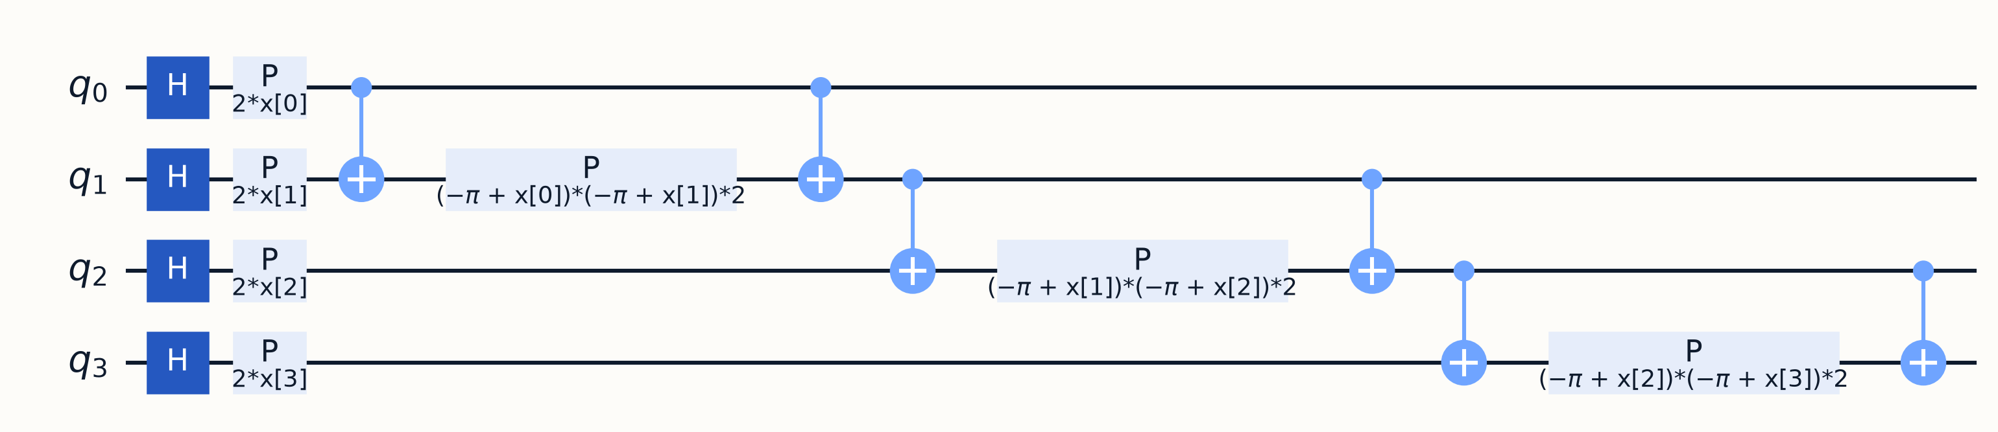
Quantum Models
QUANTUM MODELLING
TRACK B
Step 1: Turning samples into quantum states
Input
Features
Compression
Angles
Circuit
Atoms Z, coordinates R
188 numbers per molecule
Scaling + PLS: 10 numbers
× angle scale γ (0.020)
10 qubits, 2 passes
H
Equal mix of 0 and 1 on every qubit
P(2·x[i])
Turns a qubit's phase by an amount set by one input
One pass of the ZZ encoder, drawn for 4 of the 10 qubits. x[i] = γ × input i.
⊕ – P – ⊕
The pass runs twice on 10 qubits (36 two-qubit gates). The output is a quantum state of 1,024 amplitudes.
Entangling block: adds a phase set by two neighbouring inputs together
Notes:
(~45 s) Here is how a molecule becomes a quantum state. Its atoms and coordinates become 188 features, which we scale and compress to 10 numbers with partial least squares, one per qubit. Each number is multiplied by the angle scale gamma and becomes a rotation angle. The circuit, shown for 4 qubits, starts each qubit in an equal mix of 0 and 1 with a Hadamard gate, turns each qubit's phase by its input, and then links neighbouring qubits with an entangling block whose phase depends on two inputs together. That pass runs twice on 10 qubits. The result is a quantum state with 1,024 amplitudes, which a laptop can simulate exactly.

Slide 16
Step 2: three ways to read the state out
QUANTUM MODELLING
TRACK B
Fidelity kernel (QKRR)
Projected kernel
⟨Z⟩ feature ridge
k(x, x′) = |⟨ψ(x)|ψ(x′)⟩|²
30 measured numbers + RBF kernel
10 measured numbers + ridge
MEASURES
MEASURES
MEASURES
How much two molecules' states overlap: run U(x′), then U(x) reversed, and count all-zero readouts
⟨X⟩, ⟨Y⟩ and ⟨Z⟩ of every qubit: 30 numbers per molecule
⟨Z⟩ of every qubit: 10 numbers per molecule, all from one circuit
THEN
THEN
THEN
Kernel ridge regression on the table of similarities between training molecules
A classical RBF kernel on those 30 numbers, then kernel ridge regression
Linear ridge regression on those 10 numbers
CIRCUITS
CIRCUITS
CIRCUITS
1 per pair of molecules
3 per molecule
1 per molecule
Test MAE at 1,000 labels: 0.492 D
Test MAE at 1,000 labels: 0.493 D
Test MAE at 1,000 labels: 0.545 D
All three predict √|μ| and square it back to debye. The angle scale γ and ridge penalty α are chosen by 5-fold cross-validation inside the training set, the same way as for the classical twin.
Notes:
(~50 s) Once each molecule is a quantum state, there are three ways to read it out. The fidelity kernel, our headline model, measures how much two molecules' states overlap, which needs one circuit for every pair of molecules, and feeds that similarity table to kernel ridge regression. The projected kernel instead measures three numbers per qubit, 30 per molecule, and compares molecules with an ordinary classical kernel on those numbers: three circuits per molecule. The Z feature ridge measures one number per qubit, 10 per molecule from a single circuit, and fits a linear formula. All three are tuned exactly like their classical twin. The two kernels tie it at 0.49 debye.

Slide 17
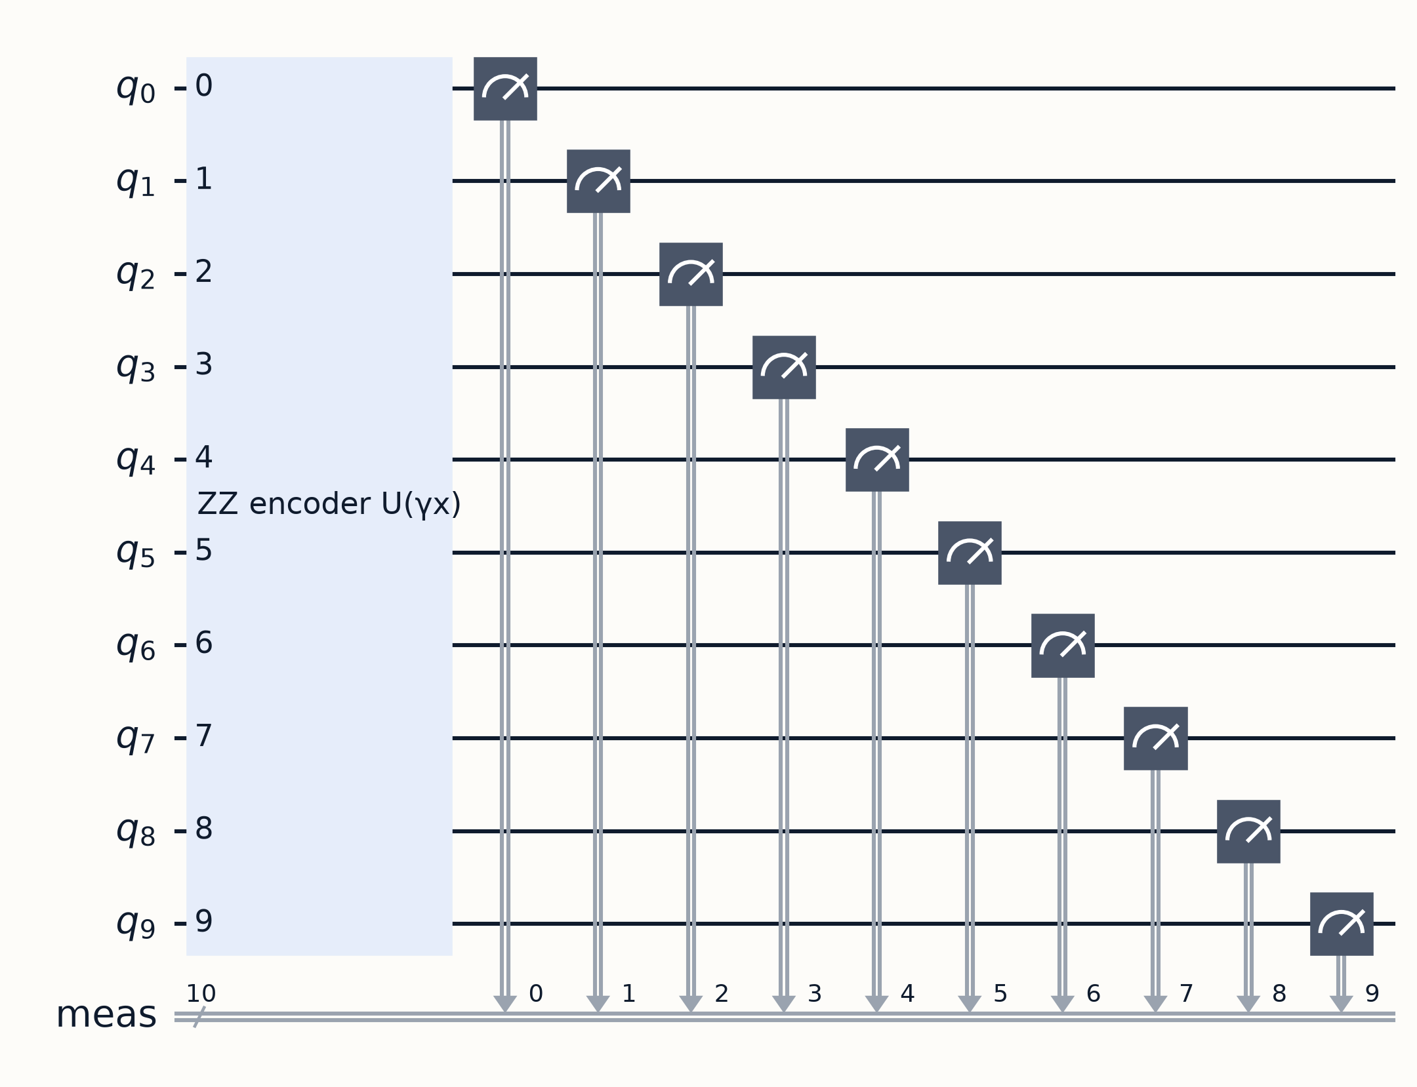
The ⟨Z⟩ feature ridge, step by step
QUANTUM MODELLING
TRACK B
1
Encode
The molecule's 10 numbers, times γ, become the rotation angles.
2
Measure
Every qubit reads 0 or 1. Repeat 1,000 times.
3
Average
⟨Z⟩ = (zeros − ones) ÷ 1,000 for each qubit: 10 numbers per molecule.
4
Predict
√|μ| = b + w₁⟨Z₁⟩ + … + w₁₀⟨Z₁₀⟩, squared back to debye. The 11 numbers b and w are fitted on training molecules.
The circuit sent to ibm_quebec: the 10-qubit encoder, then all 10 qubits measured.
Example: qubit 3 of one molecule read 0 on 700 shots and 1 on 300, so ⟨Z₃⟩ = (700 − 300) ÷ 1,000 = 0.40.
Notes:
(~45 s) This is the model we ran on hardware, the Z feature ridge. One: the molecule's 10 numbers become the circuit's rotation angles. Two: the device runs the circuit and every qubit reads 0 or 1, and we repeat that 1,000 times. Three: for each qubit we compute the average, zeros minus ones divided by 1,000, which gives one number between minus one and one per qubit. For example, 700 zeros and 300 ones gives 0.4. Four: a linear formula with 11 fitted numbers turns those 10 values into a dipole prediction. The quantum circuit itself is fixed; only those 11 numbers are learned.

Slide 18
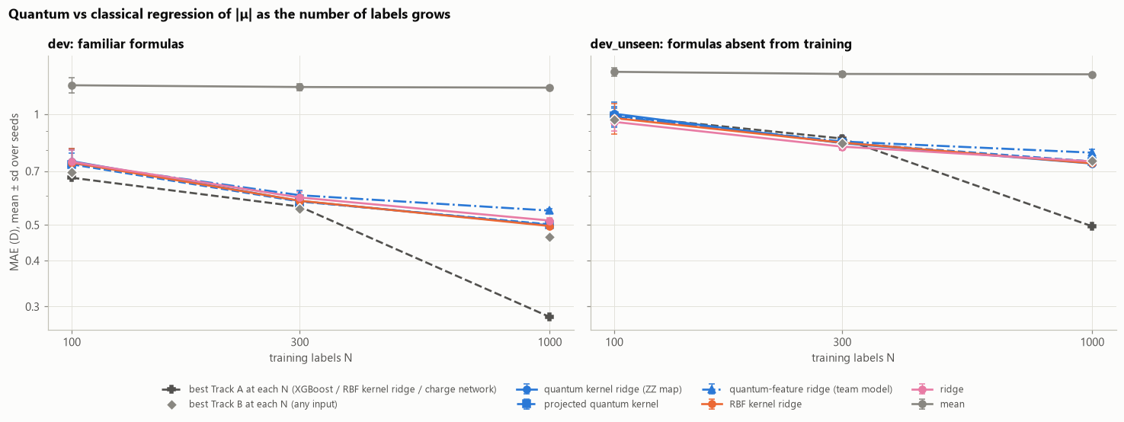
Quantum Vs Classical
MODELLING
TRACK B
Simulated model performance over 3 seeds
Notes:
(~40 s) A quantum circuit takes one input per qubit, and we budgeted 10 qubits, so the 188 features had to be compressed to 10 numbers. We compared three methods with the same classical model. PCA keeps the directions where the data varies most, but it never looks at the dipole, and it did worst. Picking the 10 individually best features did better. Partial least squares finds the directions that vary together with the dipole, and it won clearly, so every quantum model and its classical twin use those 10 PLS components. Ten was the fewest components that came within noise of the best result. Because PLS uses the labels, we refit it inside every training fold so no validation or test answer leaks in.

Slide 19
Entanglement made no measurable difference.
WHY THEY TIE
0.490 D
71.4 vs 71.7
≈ 0
A product-state kernel with no entangling gates, vs 0.492 D for the ZZ map (N = 1,000)
Effective parameters of the quantum kernel and of RBF kernel ridge, at the settings CV chose
Mean off-diagonal kernel entry on 16 qubits at γ = 1: at larger angles every molecule looks orthogonal
Cross-validation picks the smallest angle scale, where the fidelity kernel behaves like a wide classical RBF kernel. That is the regime where it works, and in that regime it is effectively classical.
Notes:
(~45 s) Why do they tie? A product-state kernel, with no entangling gates at all, scores exactly the same. At the settings cross-validation chose, the quantum kernel and the RBF kernel use the same effective number of parameters, about 71. The reason is a known problem called exponential concentration: at larger rotation angles, the overlap between any two molecules' states goes to zero, about zero on 16 qubits, so the kernel can't tell molecules apart. Cross-validation therefore picks the smallest angles, where the quantum kernel is effectively a smooth classical kernel.

Slide 20
Isolating molecule representation choices
MEASURING PERFORMANCE
Relevant representations/inputs to measure:
01 – Composition-only
02 – Geometry-aware
Count of 5 atoms (C, H, N, O, F)
5 qubits
All 188 descriptors, compressed to 10
10 qubits
Notes:
One of our measurable goals was to see how well we represented molecules to train our models with (j). One of the ways we achieved this was by isolating composition-only inputs versus geometry-aware inputs
The composition-only inputs are represented by the 5 atoms C, H, N, O, and F, with each atom being represented by a qubit
The geometry-aware inputs are represented by all 188 descriptors, which are compressed to 10 qubits

Slide 21
The effect of geometry on training size
MEASURING PERFORMANCE
Measuring MAE for composition-only versus geometry-aware
 | n_train | 100 | 300 | 1000
features | model
composition | projected quantum kernel | 1.050 | 1.018 | 0.985
 | quantum kernel ridge (ZZ map) | 1.037 | 1.025 | 0.986
 | RBF kernel ridge | 1.025 | 1.016 | 0.986
kbest10 | projected quantum kernel | 0.731 | 0.622 | 0.575
 | quantum kernel ridge (ZZ map) | 0.718 | 0.620 | 0.568
 | RBF kernel ridge | 0.681 | 0.612 | 0.551
pca10 | projected quantum kernel | 0.879 | 0.790 | 0.706
 | quantum kernel ridge (ZZ map) | 0.806 | 0.784 | 0.706
 | RBF kernel ridge | 0.838 | 0.770 | 0.698
pls10 | projected quantum kernel | 0.731 | 0.579 | 0.502
 | quantum kernel ridge (ZZ map) | 0.745 | 0.581 | 0.499
 | RBF kernel ridge | 0.738 | 0.582 | 0.497
Notes:
(table) As seen, we measured the mean absolute error for each test molecule across three of our models. Additionally, we account for training set size by testing across 100, 300, and 1000 molecules
For the composition-only inputs, we observe a relatively higher error, which stays roughly consistent across different training set sizes—this is expected, as none of the three models have a way of differentiating the dipole moment magnitude of isomers
By factoring in geometry into the inputs, which we do in three different ways with kbest10, pca10, and pls10, we observe how geometry-aware inputs improve the performance of the model, and that the mean absolute error decreases much more across larger training set sizes in comparison to the composition-only inputs
In fact, we see that geometry-aware inputs for just an N=100 size beats a composition-only input of size N=1000!

Slide 22
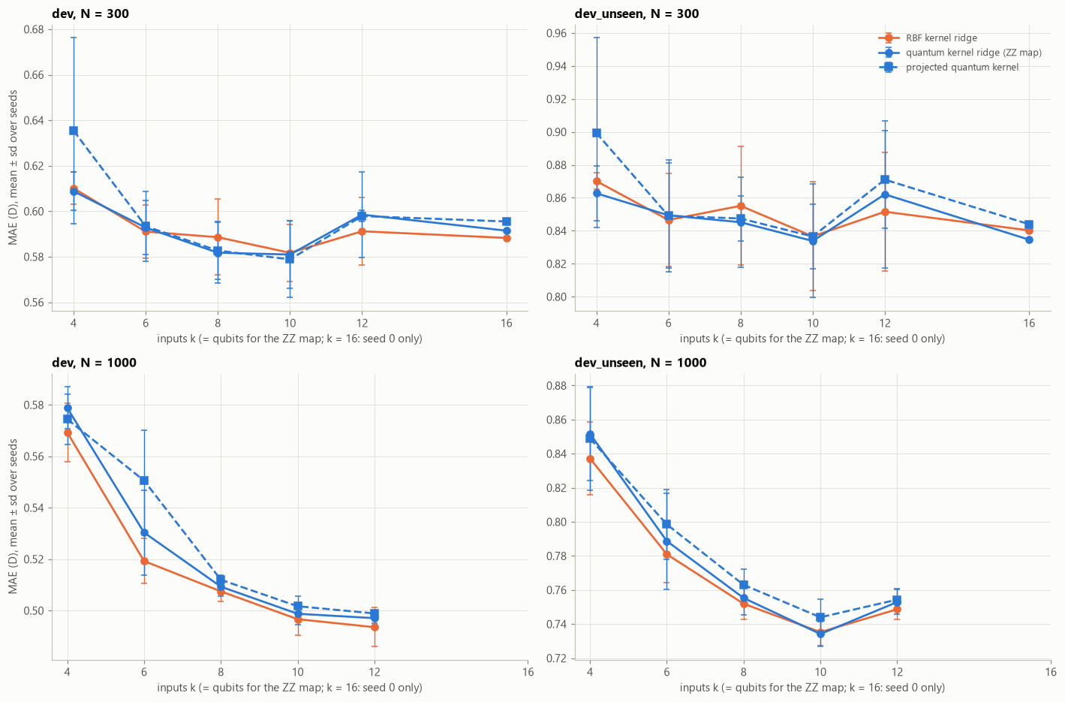
Validation—the effect of extra qubits
MEASURING PERFORMANCE
Geometry-aware inputs appear to out-perform composition-only inputs
Validate: does the number of qubits (k) impact performance?
  Test k = 4, 6, 8, 10, 12, 16
Measuring MAE across different k qubits
 | n_train | 100 | 300 | 1000
model | k
projected quantum kernel | 4 | 0.705 | 0.635 | 0.574
 | 6 | 0.705 | 0.593 | 0.551
 | 8 | 0.722 | 0.583 | 0.512
 | 10 | 0.731 | 0.579 | 0.502
 | 12 | 0.755 | 0.598 | 0.499
 | 16 | 0.719 | 0.596 | nan
quantum kernel ridge (ZZ map) | 4 | 0.699 | 0.609 | 0.579
 | 6 | 0.698 | 0.593 | 0.530
 | 8 | 0.726 | 0.582 | 0.509
 | 10 | 0.745 | 0.581 | 0.499
 | 12 | 0.755 | 0.598 | 0.497
 | 16 | 0.699 | 0.591 | nan
RBF kernel ridge | 4 | 0.694 | 0.610 | 0.569
 | 6 | 0.694 | 0.591 | 0.519
 | 8 | 0.715 | 0.589 | 0.507
 | 10 | 0.738 | 0.582 | 0.497
 | 12 | 0.744 | 0.591 | 0.494
 | 16 | 0.772 | 0.588 | nan
Notes:
Although it seems clear to us that geometry-aware inputs out-perform composition-only inputs, it is important to account for external factors. One such factor that we simulated was the number of k qubits.
(table) Since geometry-aware inputs are represented by 10 qubits in comparison to the 5 qubits of composition-only inputs, you could make the assumption that the extra qubits factor into the lower mean absolute error
To verify this, we compressed the 188 descriptors for the geometry-aware inputs to k = 4, 6, 8, 10, 12, and 16 qubits.
We observed that even for a faster and cheaper k = 4 qubits, the geometry-aware inputs out-performed the 5-qubit composition-only inputs by quite a lot.
(graph) We also observed that 10 qubits was the sweet spot and that any more qubits yielded diminishing returns, as visualized on the graph
Hence, we can conclude that our representation choice of compressing each molecule’s 188 descriptors to geometry-aware, 10-qubit inputs is beneficial to our performance even when factoring training-set size and cost

Slide 23
The quantum models tie their classical twin
MODELLING
Model (PLS 10) | N = 100 | N = 300 | N = 1,000 | Unseen, N = 1,000
QKRR, ZZ map | 0.735 ± 0.062 | 0.578 ± 0.011 | 0.492 ± 0.008 | 0.437 ± 0.010
Product-state kernel | 0.732 ± 0.075 | 0.578 ± 0.011 | 0.490 ± 0.009 | 0.433 ± 0.009
Projected quantum kernel | 0.724 ± 0.057 | 0.578 ± 0.013 | 0.493 ± 0.007 | 0.440 ± 0.016
⟨Z⟩ feature ridge | 0.731 ± 0.072 | 0.597 ± 0.010 | 0.545 ± 0.011 | 0.493 ± 0.021
RBF kernel ridge | 0.730 ± 0.075 | 0.578 ± 0.010 | 0.490 ± 0.009 | 0.433 ± 0.010
RBF kernel ridge, all 188 features | 0.662 ± 0.040 | 0.549 ± 0.012 | 0.453 ± 0.009 | 0.420 ± 0.015
Predicting the mean | 1.156 | 1.142 | 1.138 | 1.254
Test MAE in debye, mean ± sd over 3 seeds. Paired difference, quantum - twin, at N = 1,000: +0.001 ± 0.001 D on familiar formulas and +0.004 ± 0.001 D on unseen ones.
Notes:
(~50 s) First result, on the held-out test sets. The headline quantum model, quantum kernel ridge on 10 qubits, reaches 0.492 debye mean absolute error with 1,000 labels, and 0.437 on formulas it never saw. Its classical twin, RBF kernel ridge on the same 10 inputs, gets 0.490 and 0.433. The paired difference is a thousandth of a debye. Every quantum variant lands in the same place, including the control with no entanglement. The team's Z-feature model is a bit weaker. And a classical kernel that isn't limited to 10 inputs does better still, at 0.453.

Slide 24
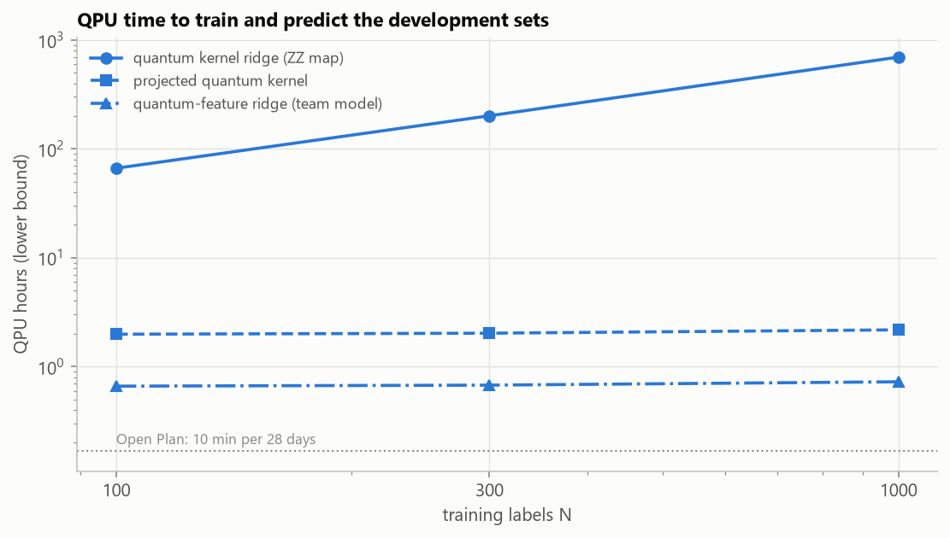
What it would cost on IBM hardware
COST, SHOTS AND NOISE
To train on 1,000 molecules and predict both test sets (22,302 molecules), at 1,000 shots per circuit:
≈ 1,640 h
Fidelity kernel (QKRR)
499,500 circuits to train
≈ 5 h
Projected kernel
3,000 circuits to train
≈ 1.7 h
⟨Z⟩ feature ridge
1,000 circuits to train
Lower bound on QPU hours to train and predict the 9,183 development molecules at 1,000 shots per circuit. Dotted line: IBM's free Open Plan, 10 minutes per 28 days.
Compiled for IBM hardware, one kernel entry is a circuit of depth 206 with 70 two-qubit gates; the encoder alone is depth 109 with 36.
Notes:
(~40 s) Simulation hides the cost. On a real device every kernel entry is its own circuit, so the fidelity kernel needs one circuit per pair of molecules: almost half a million just to train on 1,000 molecules, and about 1,640 QPU hours to train and predict our test sets at 1,000 shots. The feature-based models need one or three circuits per molecule: about 1.7 and 5 hours. For scale, IBM's free plan gives 10 minutes a month. Compiled for IBM hardware, one kernel circuit is 206 layers deep with 70 two-qubit gates, the main source of hardware error.

Slide 25
Running our model on IBM hardware
IBM QUANTUM HARDWARE
Model
Rehearsal
Device job
Readout
⟨Z⟩ feature ridge, one circuit per molecule
Same circuits on a FakeQuebec noise model
160 circuits × 1,000 shots on ibm_quebec
Ridge refit on the device's measurements
160
45 s
1,000
circuits: 100 training and 60 test molecules, 10 qubits each
of QPU time charged (41 s estimated), after about 85 minutes in the queue
shots per circuit, with no error mitigation
On the quantum processor: only the 160 circuits.
On our laptop: feature scaling, PLS, the ridge fit and conversion to debye.
IBM job db3da0kvf2bc73csuk60, qiskit-ibm-runtime SamplerV2, accessed through PINQ², tested on 30 familiar and 30 unseen-formula molecules
Notes:
(~40 s) We then ran the team's Z feature ridge on IBM's ibm_quebec processor, through PINQ squared. We picked it because it needs only one circuit per molecule. First we rehearsed the exact same circuits on a simulated noise model of that device on our laptop. Then we sent one job: 160 circuits, for 100 training and 60 test molecules, 1,000 shots each, with no error mitigation. It used 45 seconds of QPU time, close to our 41-second estimate, after about 85 minutes in the queue. The ridge readout was then refit on the device's own measurements.

Slide 26
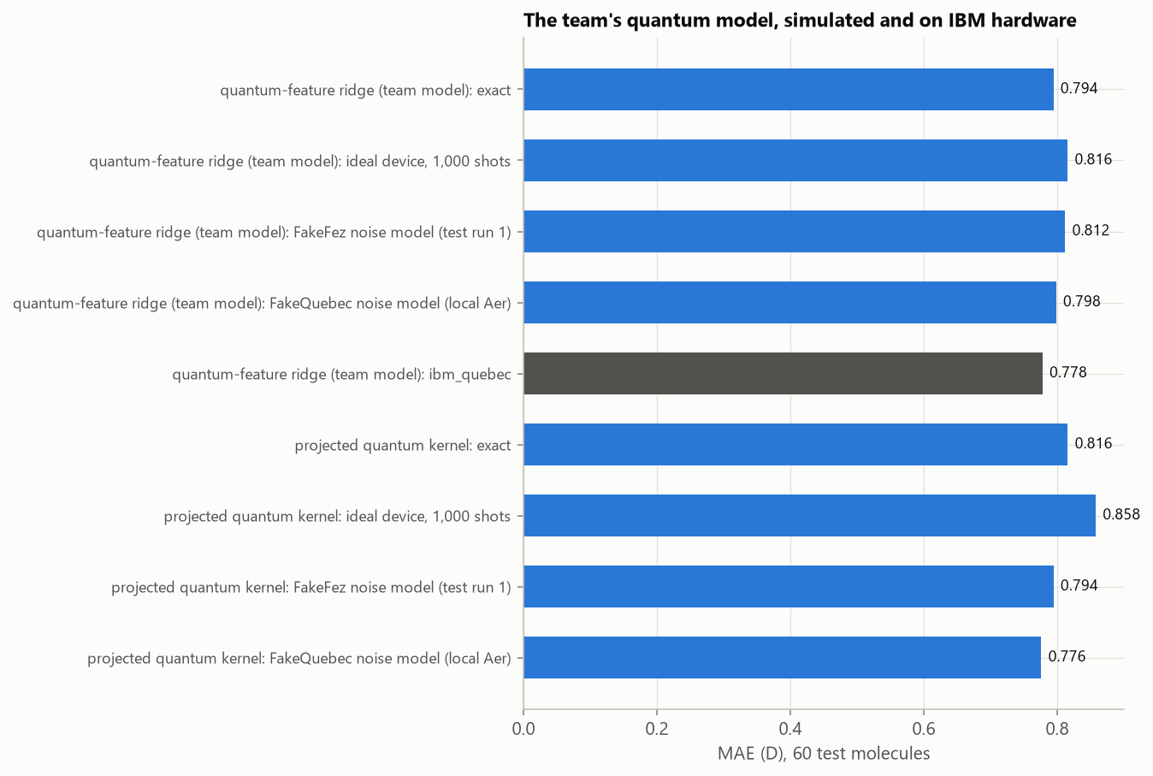
Hardware matched exact simulation
IBM QUANTUM HARDWARE
0.778 D
⟨Z⟩ feature ridge on the real device, ibm_quebec
0.794 D
The same model in exact simulation
With 60 test molecules, each score is uncertain by ±0.1 D, the device about as well as the simulator.
Model training took 45 seconds on ibm_Quebec
MAE on the same 60 test molecules, trained on 100. Dark bar: the real device.
IBM job db3da0kvf2bc73csuk60 - raw shot outcomes in results/hardware/
Notes:
(~40 s) The result: 0.778 debye on the real device, against 0.794 in exact simulation, and about 0.8 on the simulated noise models. With only 60 test molecules each number is uncertain by about a tenth of a debye, so the honest reading is that the device did as well as perfect simulation, not better. Refitting the readout on the device's own noisy measurements is what makes this model robust: it learns around the noise.

Slide 27
Answers to our four questions
CONCLUSIONS
01
How fast does error fall as labels grow?
02
Can a quantum model match its classical twin?
Any 10-input model reaches around 0.5 D with 1,000 labels. While optimized classical networks can reach 0.095 D at 10,000 and 0.040 D at 99,198.
Yes, under some circumstances. Every quantum kernel ties RBF kernel ridge within 0.005 D, and a circuit with no entanglement ties too.
03
Do models work on formulas never seen in training?
04
Does it survive shots, noise and real hardware?
Yes. On the test set, unseen-formula error was 0.88–0.98× the familiar error for every model. How hard it is depends on which formulas are held out.
We found that at least shot-aware or feature-based models do. Our ⟨Z⟩ ridge ran on ibm_quebec as accurately as in exact simulation.
Notes:
(~50 s) Back to our four questions. One: any model on our 10 inputs reaches about half a debye with 1,000 labels; to get below a tenth of a debye you need a physics-shaped model and about 10,000 labels, and with all 99 thousand it reaches 0.04. Two: no, the quantum kernels tie their classical twin, and the no-entanglement control ties too. Three: on the test set, new formulas were no harder, though on our development holdout they were, so it depends on which formulas you hold out. Four: on a real device only shot-aware or feature-based quantum models work, and our Z ridge ran on IBM hardware as accurately as in simulation.

Slide 28
NEXT STEPS
What we would do if we had more time:
Try to train and test a more complex model on quantum hardware
Explore other types of Quantum models and architectures like splines, ensembles, trees
Explore different quantum encodings and feature sets
Explore Chemistry to understand features and their correlations more intuitively for the sake of designing more robust models and features

Slide 29
THANK YOU!

